Slide 1


Sharon K. Bard Todd A. Doehring
Centrec Consulting Group, LLC, Savoy, Illinois Centrec Consulting Group, LLC, Savoy, Illinois
Steve T. Sonka
University of Illinois, Urbana-Champaign
Presented at the Fifth GOES Users’ Conference
January 24, 2007
88th AMS Annual Meeting, New Orleans, LA

Slide 2
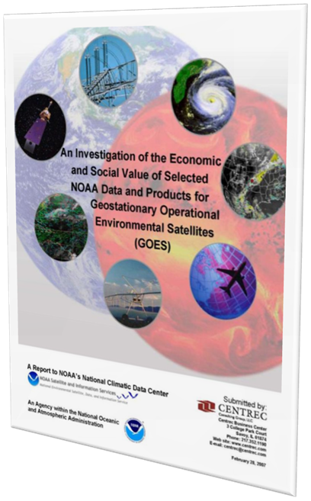
An Investigation of the Economic and Social Value of Selected NOAA Data and Products for GOES Report

Slide 3
Objective of Study
To estimate the potential socio-economic benefits of GOES-R in selected application areas
  Valuation of improved tropical cyclone (TC) forecast information along the Gulf and Atlantic coastlines
  Updated quantification of benefits previously estimated for aviation, energy (electricity and natural gas), irrigated agriculture, and recreational boating (“GOES-R Sounder and Imager Cost/Benefit Analysis”, 2002)

Slide 4
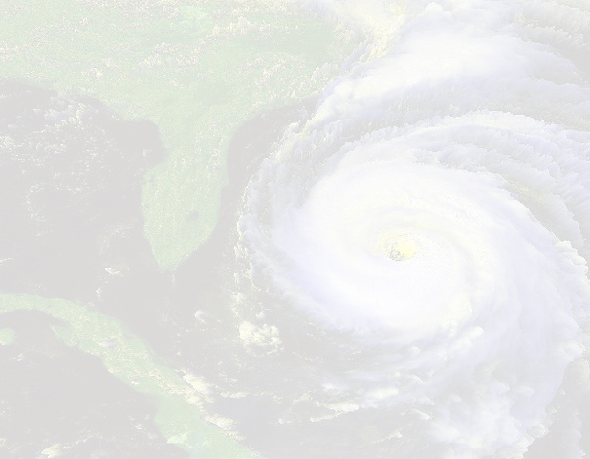

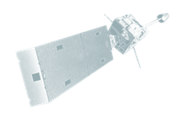


Improved Tropical Cyclone Forecasts – Technological Assumptions
Instruments – ABI and possible high resolution spectral sounder
Key impacts on TC forecasts
  More accurate intensity and track forecasts through reduced forecast errors
  Secondary implications could be tightening of wind speed probability fields and improved surge forecasts
Derived products and data
Reduced
watch / warning & evacuation areas
IMPROVED DATA
Forecasts for track,
intensity, storm size, etc
Guidance
Increased public response rate
NWP model initialization
Analysis of current conditions
NHC Official
TC forecasts and advisories
Observations

Slide 5
Reduced Watch / Warning Areas
More accurate TC forecasts should
reduce watch and warning areas
B
A
Coastline
B1
A1
Graphic used for illustrative purposes only
Coastline

Slide 6


Increased Public Responsiveness
More accurate TC forecasts should
increase the public’s responsiveness
Protection
 | Protection costs
 | Property damage
 | Net economic effect
Evacuation
 | Evacuation costs
 | Economic loss of life and injury
 | Net economic effect
Reduced Evacuation Area
 | Overall evacuation costs
 | Net economic effect

Slide 7
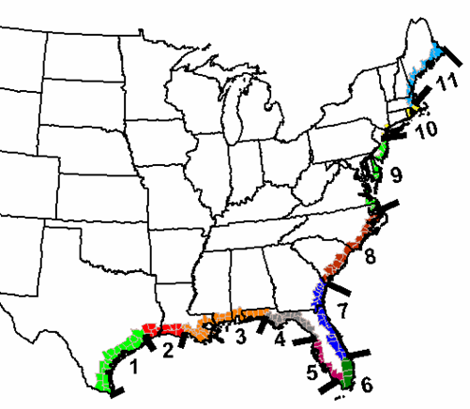
Analysis Framework
The Tropical Cyclone Forecast Valuation Tool, an Excel-based model, was developed to implement the methodology
  Relevant geographic area: Atlantic and Gulf coastlines
  Used estimated annual, county-level probabilities of landfall or being in vicinity for tropical storms; S-S 1 & 2; and S-S 3, 4 & 5 hurricanes¹
¹ Compiled by the U.S. Landfall Probability Project

Slide 8
Analysis Scenarios¹
 | Base Case (ABI) | Enhanced Technology (ABI plus HRSS)
Instrument focus | ABI | ABI plus more accurate technology performance such as a high resolution spectral sounder (HRSS)
Improved GEO data’s impact on TC forecasts | Analysts’ most conservative estimates | More aggressive estimates²
Impact on watch/warning and evacuation areas | 5% | 15%
¹ Only two of eight different scenarios considered in the report are presented.
² The assumptions made for this scenario are intentionally aggressive values and are not based on social behavior or scientific evidence due to the limited research on this topic. Nonetheless, while these assumptions might not be scientifically expected today, they are meant to illustrate the potential benefits if proved true in the future.

Slide 9
Estimated Benefits
Total Net Benefits | Base Case (ABI) | Enhanced Technology (ABI plus HRSS)
Non-discounted net benefits for the single year 2015 | $452 M | $814 M
Total NPV¹ benefits for 2015 - 2027 | $2,376 M | $4,278 M
Per Coastline Mile
Non-discounted net benefits for the single year 2015 | $130 K | $233 K
Total NPV¹ benefits for 2015 - 2027 | $690 K | $1,227 K
¹ NPV – Net Present Value discounted at 7% with 1.5% population growth and no inflation

Slide 10
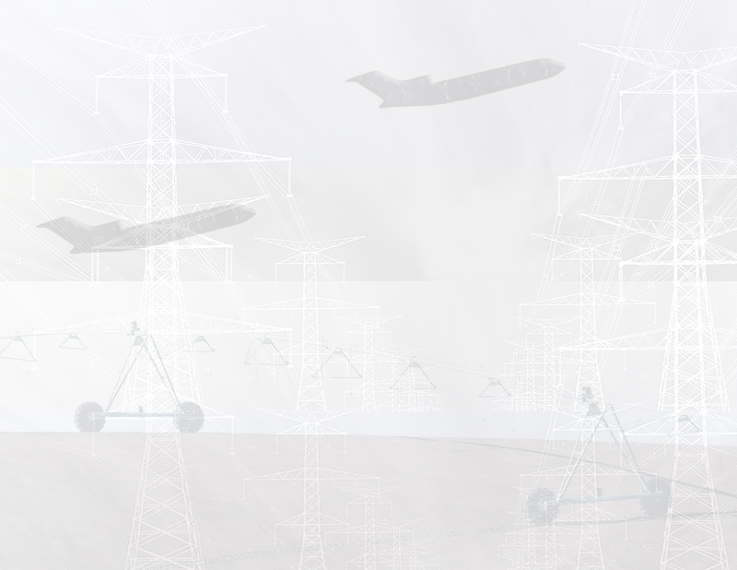
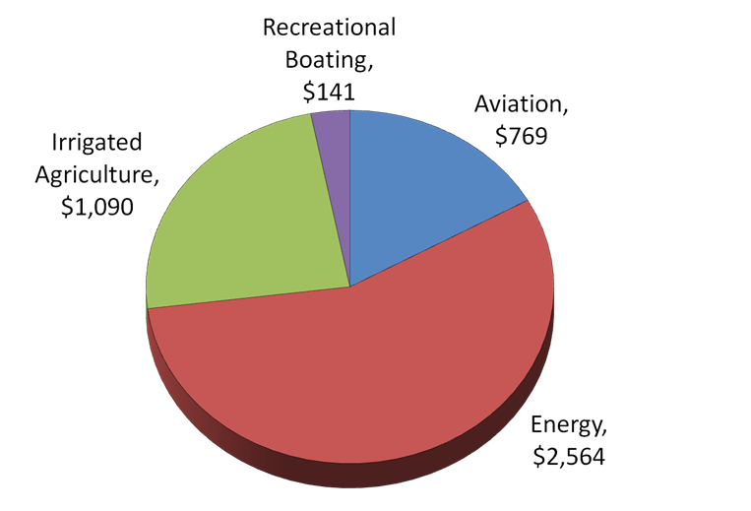
Updated Cost-Benefit Analysis
Net Present Value¹
of Benefits
from 2015-2027
($ Mil)
Total Benefits -
$4,563 Mil
¹ Discounted at 7%

Slide 11
Summarized Potential NVP¹ Benefits Beyond Current GOES Series
ABI-related
and high resolution spectral sounder technology -
$8.8 B
Other Potential Benefits ???
Improved Sounder
Updated CBA (HES)
$2.3B
ABI-Related
TC Forecast (HRSS)
$1.9B
$4.2B
Updated CBA (ABI)
$2.2B
$2.4B
TC Forecast (ABI)
$4.6B
¹ Discounted at 7%

Slide 12
Areas Not Included in Analysis
Tropical cyclone forecast analysis
  Disruptions of economic operations
  Inland damages due to rain and wind effects
Instruments – Geostationary Lightning Mapper (GLM); Solar UV Imager (SUVI); Extreme UV/X-Ray Irradiance Sensor (EXIS); Space Environmental In-Situ Suite (SEISS); Magnetometer (MAG) and Unique Payload Services
Users – international; retrospective; DoD; data collection services
Economic sectors including commercial transportation, tourism, television
Societal benefit areas such as human health, climate, ecological, ocean

Slide 13
Concluding Remarks
Potential benefits of GOES-R beyond the current system:
  ABI-related benefits - $4.6 B
  Improved GEO sounder data benefits - $4.2 B
These results most likely underestimate the potential total benefits of the GOES-R satellite system beyond the current system
GOES-R program costs were not considered in this study

Slide 14
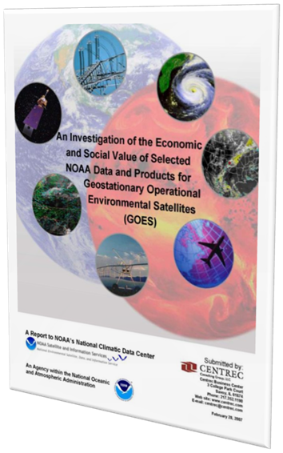
Thank you!
The report can be found at:
http://www.centrec.com/climate_weather.htm
Sharon Bard
sbard@centrec.com
Todd Doehring
tdoehring@centrec.com

